Slide 1
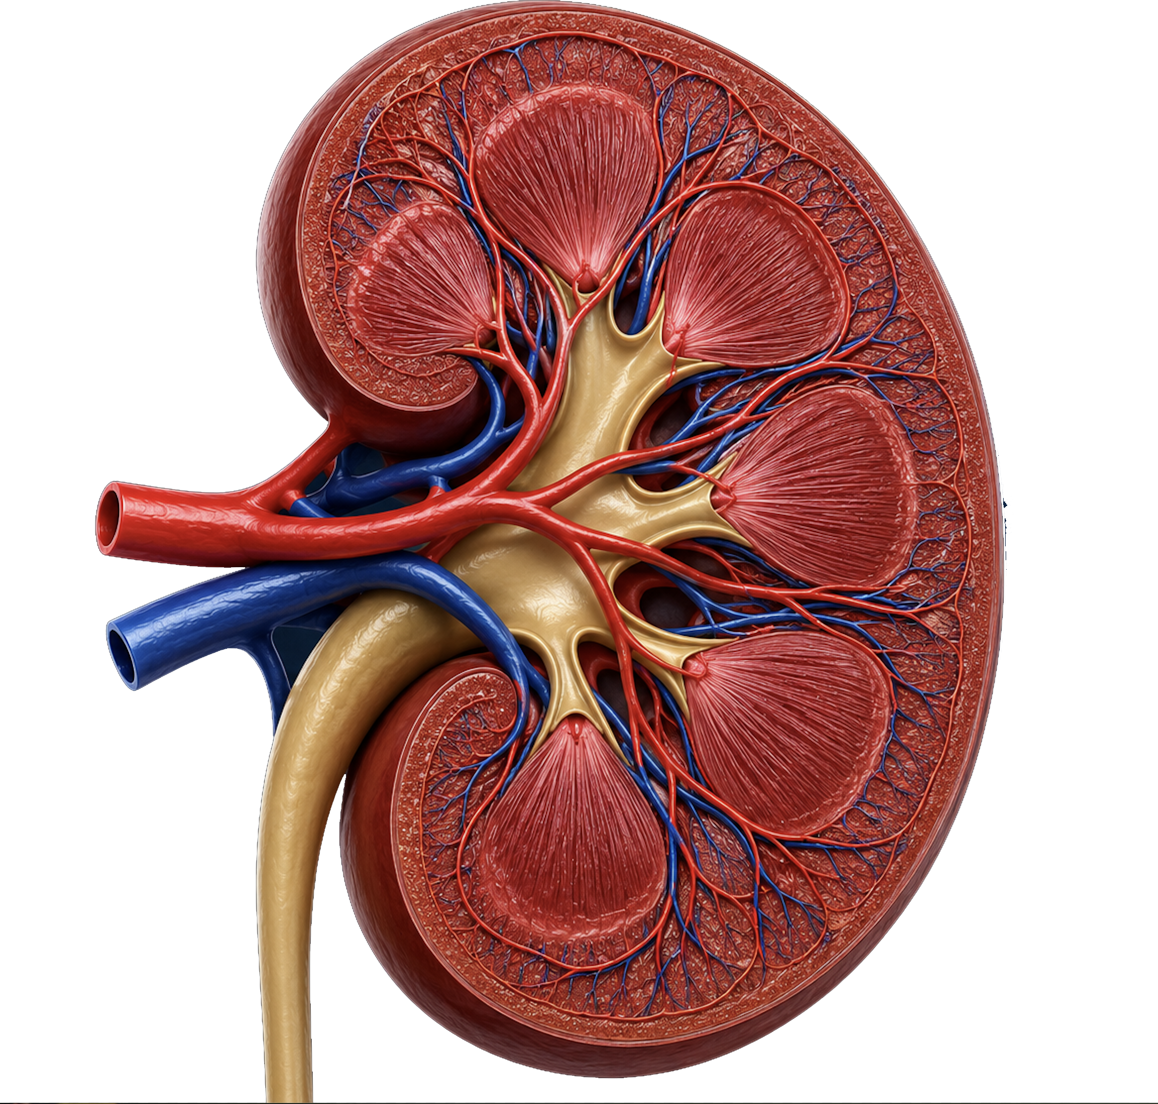
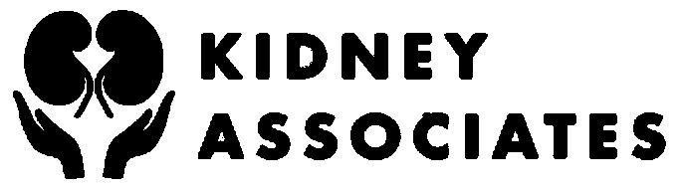
FOR PRIMARY CARE PHYSICIANS
Nephrology for the
Non-Nephrologist
How to explain progression, protect remaining kidney function, and plan future kidney care
C-G-A
Lifestyle as therapy
Home first when feasible

Slide 2
OBJECTIVES
Detect
Explain
Protect
Plan
Use eGFR, albuminuria, urine sediment, imaging, and trajectory to recognize kidney disease early.
Teach the major progression loops: hyperfiltration, metabolic injury, vascular disease, fibrosis, and aging.
Layer lifestyle, blood pressure, RAS blockade, SGLT2 inhibition, diabetes therapy, and complication management.
Avoid crash starts by preparing for home PD or hemodialysis, access, transplant, conservative care, and urgent starts.
Nephrology for the Non-Nephrologist
2

Slide 3
The literature map gives the backbone
The course is organized around recurrent domains identified through large-scale CKD literature mapping using deep learning: detection and prognosis, progression biology, diabetes and vascular disease, aging, treatment response, kidney failure preparation, dialysis modalities, transplantation, and patient-centered care.
Detection
Progression
Diabetes
Vascular risk
Aging
Therapy
Dialysis
Transplant
Patient goals
Nephrology for the Non-Nephrologist
3

Slide 4
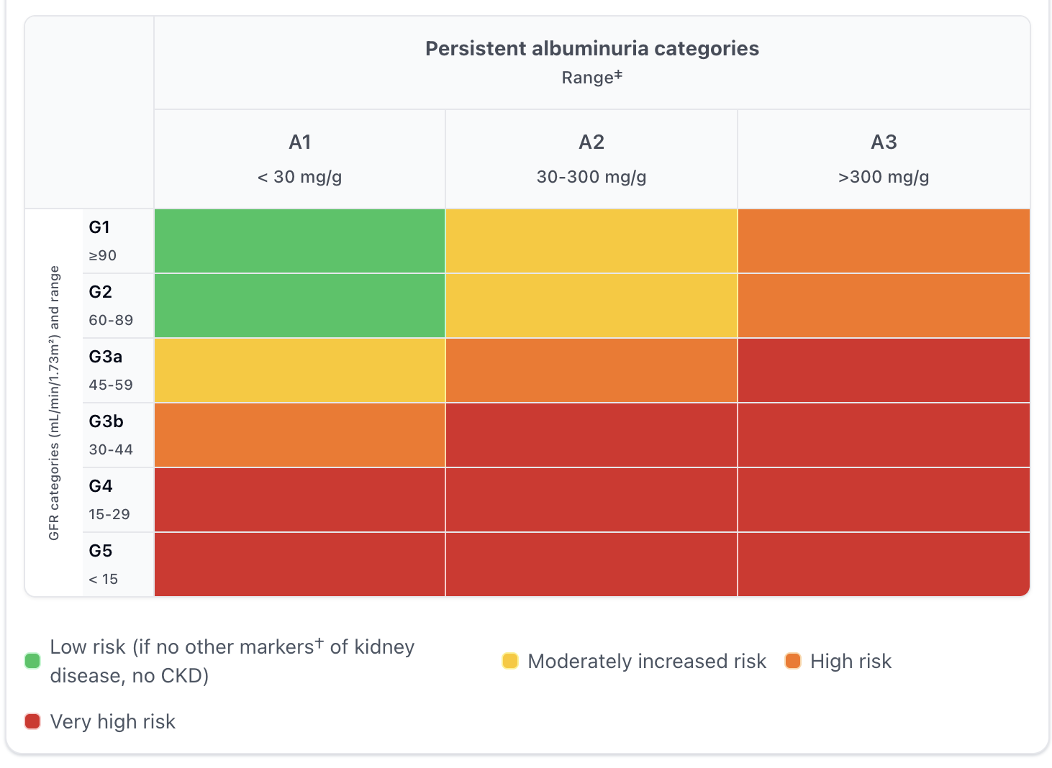
CKD Heatmap
CKD is an abnormality of kidney structure or function that has been present for at least 3 months
CAUSES: Diabetes, hypertension, glomerular disease, obstruction, cystic disease, medication injury, systemic disease, and recurrent AKI.
Nephrology for the
Non-Nephrologist
4

Slide 5
Diagnosis
Repeat elevations in serum creatinine
Order urine ACR
Urine microscopy can show hematuria, casts
The ultrasound detects obstruction, cystic disease, small kidney size, cortical thinning, and/or echogenicity.
Review for medications, NSAIDs, recent contrast, volume status, and recent illness.
The trap
A normal-looking creatinine can hide low GFR in older adults or low muscle mass.
The clue
Albuminuria, active sediment, and trajectory often reveal the real risk earlier than eGFR alone.
The habit
Use single measurement to diagnose CKD
Nephrology for the Non-Nephrologist
5

Slide 6
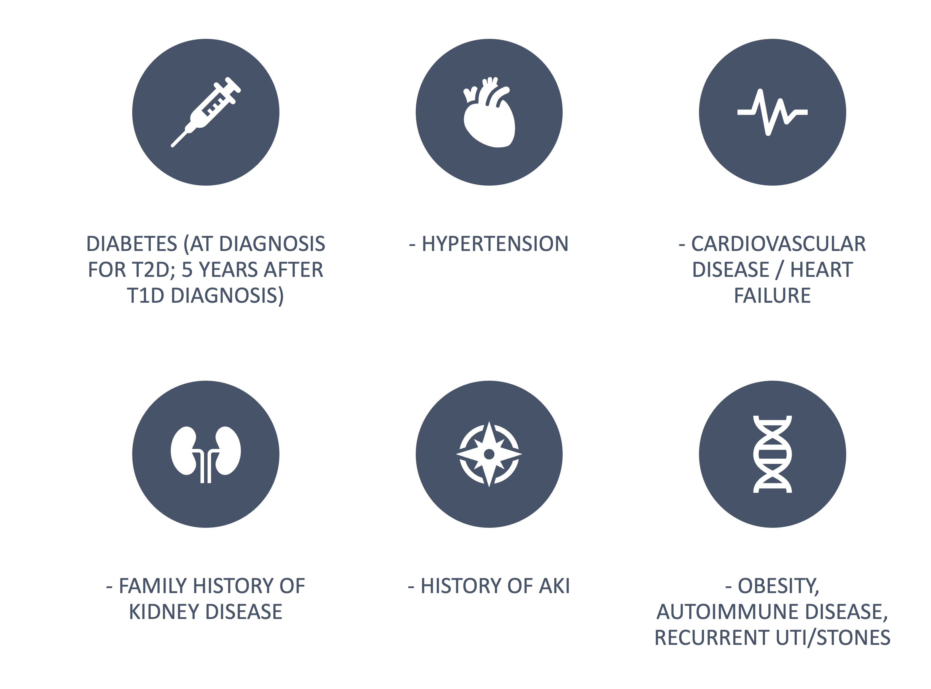
Who to screen (KDIGO 2024)
Nephrology for the Non-Nephrologist
6

Slide 7
Bedside workflow
1 eGFR trend
2 Urine ACR
3 Urine sediment
Is this stable, acute, or progressive?
Albuminuria changes prognosis and treatment.
Casts or dysmorphic RBCs change the pathway.
4 Ultrasound
5 Medication review
Obstruction, cysts, size, chronicity.
NSAIDs, contrast, lithium, PPIs, supplements.
Nephrology for the Non-Nephrologist
6

Slide 8
RED FLAGS
Urine sediment
Rapid trajectory
Heavy albuminuria
Obstruction
RBC casts, dysmorphic RBCs, WBC casts, granular casts, or unexplained hematuria with proteinuria.
eGFR fall that is faster than expected, especially with new proteinuria, systemic symptoms, or medication exposure.
ACR >300 mg/g or nephrotic-range proteinuria – consider a form of glomerulonephritis
Hydronephrosis is a reversible emergency until proven otherwise.
Stable diabetic CKD and hypertensive CKD are common, but active urine sediment, rapid decline in kidney function, or systemic features point to rapidly progressive glomerulonephritis
Nephrology for the Non-Nephrologist
6

Slide 9
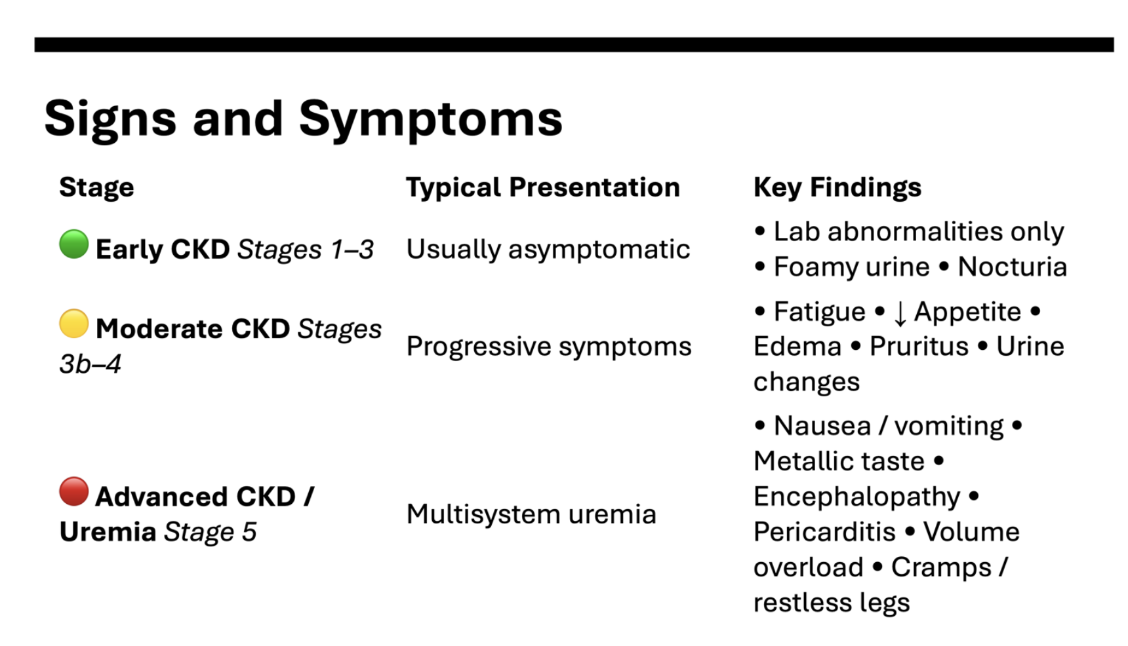

Slide 10
Mechanisms
Hyperfiltration
Sugar injury
Vascular disease
Fibrosis
Surviving glomeruli carry more pressure and flow.
Glycation, oxidative stress, podocyte injury, inflammation.
Hypertension, stiffness, ischemia, heart failure, microvascular loss.
Tubular stress, macrophages, fibroblast activation, matrix deposition.
Different diseases enter through different doors, but many converge on glomerular hypertension, endothelial injury, tubular stress, inflammation, and fibrosis.
7

Slide 11
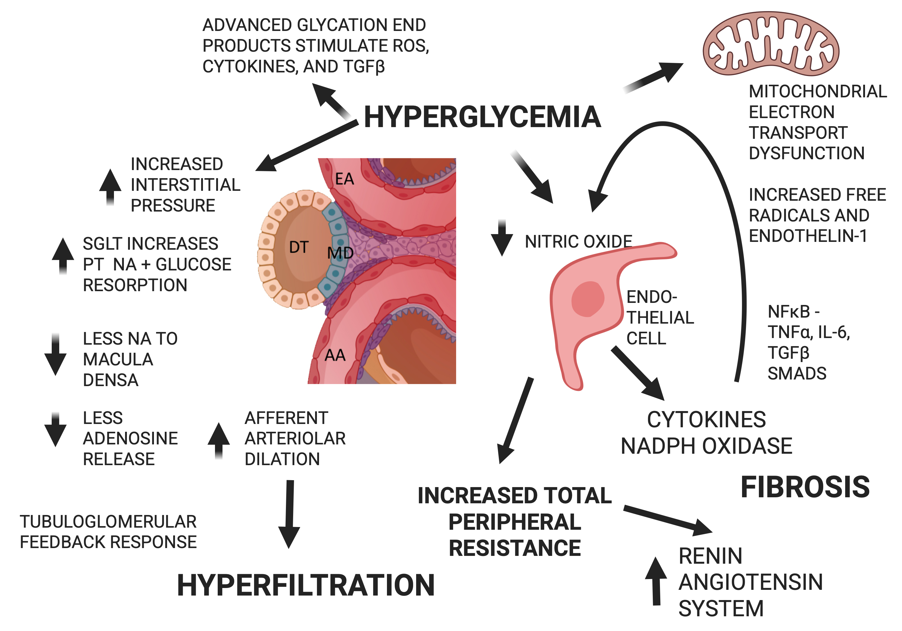

Slide 12
Hyperfiltration is compensation that becomes injury
Loss of nephron number, obesity, diabetes, high sodium intake, and high intraglomerular pressure can make remaining glomeruli work harder. The patient may look stable until albuminuria and sclerosis reveal the price.
What helps
What hurts
Lower intraglomerular pressure
ACEi/ARB,
SGLT2 inhibitor,
BP control,
Sodium reduction,
Weight strategy.
NSAIDs
Dehydration
Excess sodium
Uncontrolled diabetes Uncontrolled hypertension Recurrent AKI
Nephrology for the Non-Nephrologist
8

Slide 13
DIABETES INJURES THROUGH HEMODYNAMICS AND METABOLISM
Diabetes injures the kidney through hemodynamics and metabolism
Tubuloglomerular feedback
Barrier injury
Inflammation
More sodium-glucose reabsorption signals the kidney to hyperfilter.
Albuminuria reflects glomerular and vascular stress.
Oxidative stress and fibrosis turn metabolic injury into scarring.
Glucose control alone is not enough.
Modern care layers SGLT2 inhibition, RAS blockade, GLP-1 receptor agonists, MRA , and lifestyle therapy.
Nephrology for the Non-Nephrologist
12
9

Slide 14
CKD is often vascular disease wearing a kidney label
Hypertension transmits pressure to the glomerulus and accelerates arteriosclerosis.
Arteriosclerosis and arterial stiffness reduce renal reserve.
Heart failure and venous congestion can lower effective filtration.
Microvascular rarefaction makes the kidney less tolerant of acute illness.
Albuminuria is both a kidney signal and a vascular risk signal.
CKD care is cardiovascular prevention: BP, statin, diabetes therapy, smoking cessation, sleep apnea, exercise, and volume control.
Resistant hypertension, unexplained hypokalemia, sudden creatinine rise after RAS blockade, or asymmetric kidneys should prompt secondary-cause thinking
Nephrology for the Non-Nephrologist
10

Slide 15
Fibrosis is the final common pathway
Once injury becomes fibrosis, treatment shifts from cure to slowing loss, preventing complications, and preserving reserve. But fibrosis is not an excuse for nihilism: lowering ongoing injury still changes the slope.
Repeated injury
Tubular stress
Inflammation
Fibroblast activation
Scarring
The slope is the target: when you cannot reverse CKD, you can still slow it.
Nephrology for the Non-Nephrologist
11

Slide 16
Aging lowers reserve but does not explain everything
Expected with age
Clinical traps
Best posture
Nephron loss, glomerulosclerosis, tubular atrophy, interstitial fibrosis, vascular stiffness, and reduced reserve during illness.
Low muscle mass can hide low GFR. Polypharmacy and dehydration can mimic progression. Albuminuria is never just aging.
Use trajectory, ACR, urine sediment, cystatin C when needed, frailty, nutrition, falls, goals, and time-to-benefit.
Do not undertreat older adults because they are old; do not overtreat them as if they were young.
Nephrology for the Non-Nephrologist
12

Slide 17
Risk stratification: what should make you call nephrology?
eGFR <30 ml/min/1.73m² or rapid sustained decline.
ACR >300 mg/g, nephrotic-range proteinuria, or unexplained albuminuria.
Active urine sediment, hematuria with proteinuria, suspected glomerulonephritis.
Resistant hypertension, recurrent hyperkalemia, metabolic acidosis, anemia, CKD-MBD, or difficult volume.
Unclear cause, hereditary disease, obstruction, cystic disease, or medication toxicity.
Any patient approaching kidney failure who has not discussed modalities or transplant.
13

Slide 18
Complications
Modern CKD treatment is layered
Measures
Lifestyle
Anemia acidosis PotassiumBone-mineral disease
eGFR trend
UACR Sediment
BP
Vascular
Plant dominant
Restrict Na Weight loss
Smoking cessation
Adequate sleep
Exercise
BP control, ACEi/ARB
MRA
Coming: Endothelin agonists
Metabolism
SGLT2i, Diabetes Tx GLP-1
GLP-GIP
Which combination best lowers kidney, cardiovascular, and treatment-burden risk for this person?
Nephrology for the Non-Nephrologist
14

Slide 19
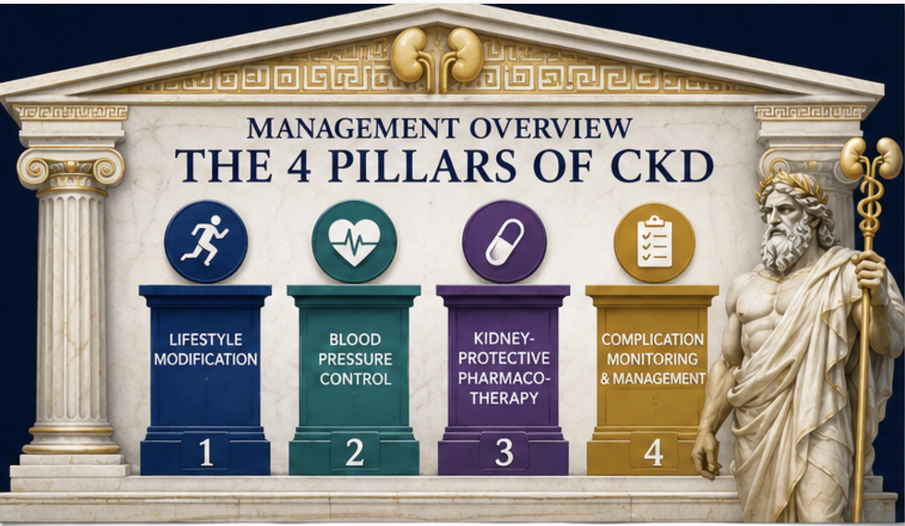

Slide 20
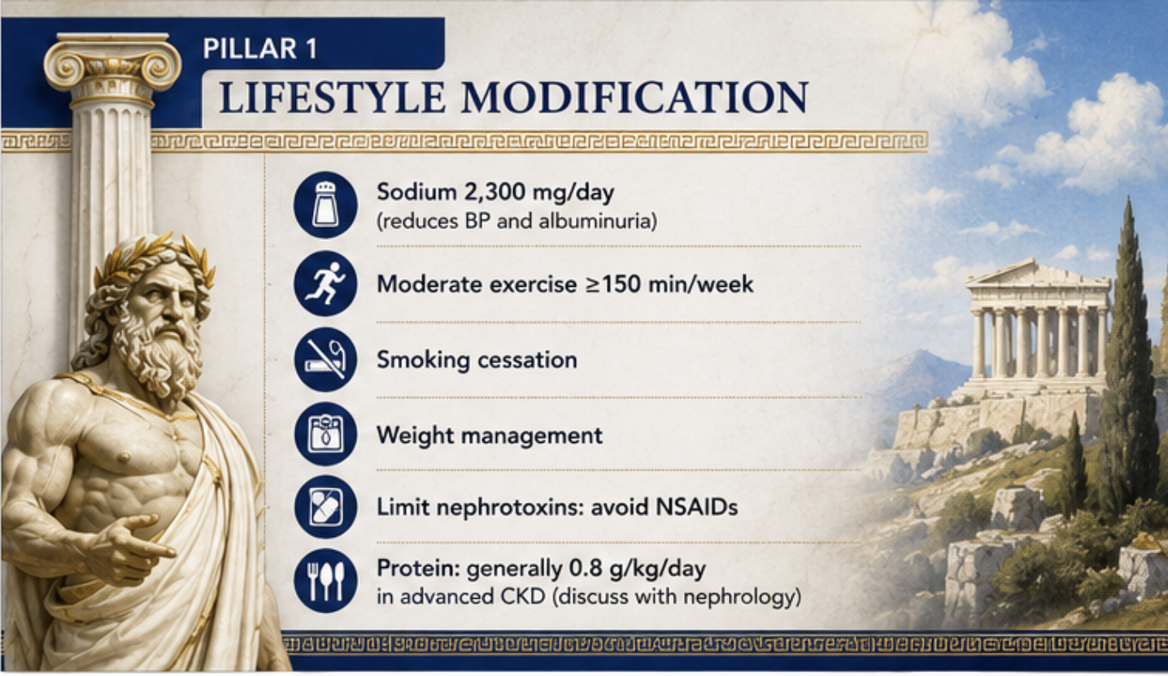

Slide 21
ACEi and ARB: protect the filter by lowering pressure
Use for albuminuric CKD when tolerated.
Use the highest approved tolerated dose to match trial evidence.
Check creatinine and potassium 2-4 weeks after start or dose increase.
Manage hyperkalemia when possible rather than reflexively stopping therapy.
Continue unless creatinine rises >30% within 4 weeks or the clinical setting demands stopping.
Teaching phrase
A small creatinine rise can mean the medicine is lowering glomerular pressure, not damaging the kidney.
Safety phrase
Do not ignore potassium, dehydration, NSAIDs, renal artery stenosis clues, or a large creatinine rise.
KDIGO 2024
16

Slide 22
SGLT2 inhibitors changed CKD from glucose care to kidney care
Mechanism
Practice
Scope
Restore tubuloglomerular feedback, lower intraglomerular pressure, reduce albuminuria, and improve cardiorenal outcomes.
Expect an early eGFR dip. Review volume status, genital infection risk, sick-day pauses, and perioperative holding.
Evidence now includes diabetic and non-diabetic CKD populations, especially albuminuric disease and heart failure.
Tell patients: "This is not just a diabetes drug. In kidney disease, it lowers pressure inside the filters and protects the heart-kidney system."
Nephrology for the Non-Nephrologist
CREDENCE; DAPA-CKD; EMPA-KIDNEY
17

Slide 23
Diabetes add-ons: GLP-1 receptor agonists and finerenone
GLP-1 receptor agonists
Finerenone
For type 2 diabetes with CKD, obesity, and cardiovascular risk, GLP-1 RA therapy can support glycemic control, weight strategy, and cardiovascular risk reduction. FLOW added dedicated kidney outcome evidence for semaglutide.
For type 2 diabetes with persistent albuminuria despite maximally tolerated RAS blockade and acceptable potassium. Monitor potassium because hyperkalemia is the practical limiting toxicity.
18

Slide 24
CKD complications
Acidosis
Hyperkalemia
Anemia
Oral alkali or diet strategy when persistent metabolic acidosis is present.
Diet review, diuretics, binders, and medication triage to preserve RASi when possible.
Iron status first; ESA only when appropriate and with target discipline.
CKD-MBD
Volume
Medication safety
Calcium, phosphate, PTH, vitamin D, diet, binders, and avoiding excess calcium load.
Sodium, diuretics, heart failure management, and dialysis planning when diuretics fail.
Dose for eGFR, avoid NSAIDs, and teach sick-day holds.
Nephrology for the Non-Nephrologist
19

Slide 25
The transition from CKD to ESKD
Scenario 1 – CRASHER - A patient with undiagnosed advanced kidney disease shows up in the emergency room in heart failure. A hemodialysis catheter is placed. The patient is dialyzed in the hospital and then discharged to a dialysis center.
Scenario 2 – URGENT START - The patient has a peritoneal dialysis catheter placed and undergoes acute peritoneal dialysis in the hospital. The patient is then referred for PD training.
Scenario 3 – OPTIMAL START – The patient is jointly followed by an internist and a nephrologist. As the disease advances, they discuss choices, and the patient chooses home PD. An embedded PD catheter is placed. When the GFR reaches around 12 cc/min, the patient is sent for training. Hospitalization is avoided.
Timing is not eGFR alone. Symptoms, complications, trajectory, access, and readiness matter.
IDEAL trial
20

Slide 26
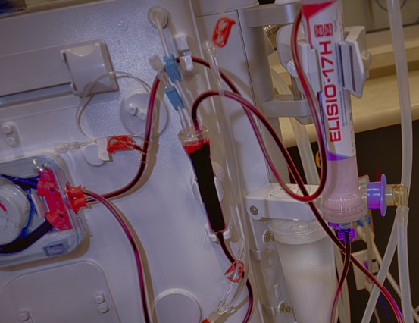
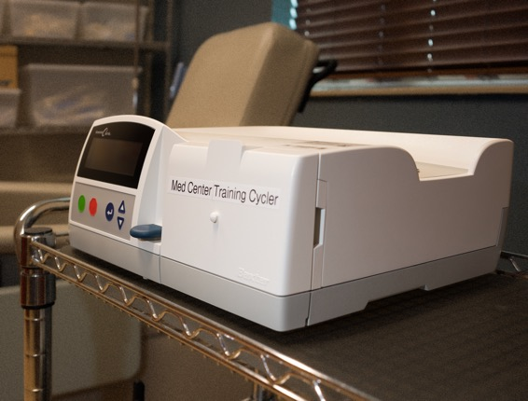
TWO TYPES OF DIALYSIS
HEMODIALYSIS
PERITONEAL
IN CENTER OR HOME
DONE AT HOME

Slide 27
Modality choice should start early
Transplant
Peritoneal dialysis
Home hemo
Best survival option
Home therapy using the peritoneal membrane; often flexible and autonomy-preserving.
Flexible HD with training; can fit patients who want more control.
In-center HD
Conservative care
Staff-delivered therapy; plan fistula or graft early if this is the route.
Active symptom-focused care without dialysis; not "no care."
Nephrology for the Non-Nephrologist
21

Slide 28

EVENTUALLY NEEDS DIALYSIS
> 60 days
NEEDS DIALYSIS
24 hr - 14 days
NEEDS DIALYSIS
14 - 60 days
Urgent Start
Routine Start
Embedded Catheter
28

Slide 29
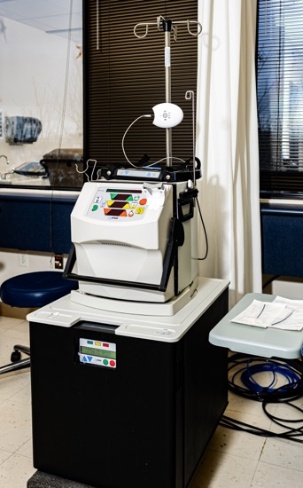
Why home is now preferred when feasible
Home therapies (PD or Hemo) can reduce travel burden and preserve autonomy.
Treatment can be integrated into work, family, sleep, and symptom patterns.
PD and home HD require education, safety screening, training, and support.
Home is a choice when the patient, home setting, and clinical situation fit.
Every modality discussion should include transplant and conservative care.
Nephrology for the Non-Nephrologist
22

Slide 30
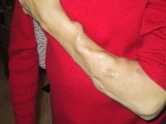
Hemodialysis access is a timeline
Education
Vein preservation
Mapping
AV fistula placement
Maturity
Cannulation
Do not use forearm veins casually in advanced CKD. Preserve veins early if dialysis may be needed.
Late referral leads to catheter starts, infections, centra vein stenosis, hospitalization, decreased home and transplant options
24

Slide 31

Myths
You cannot do PD with
  Obesity
  Advanced Diabetes
  Advanced Age
  Prior Abdominal Surgery
PD can’t be started immediately after catheter placement.
PD can’t be resumed immediately after abdominal surgery.
The moon is made of cheese.

Slide 32
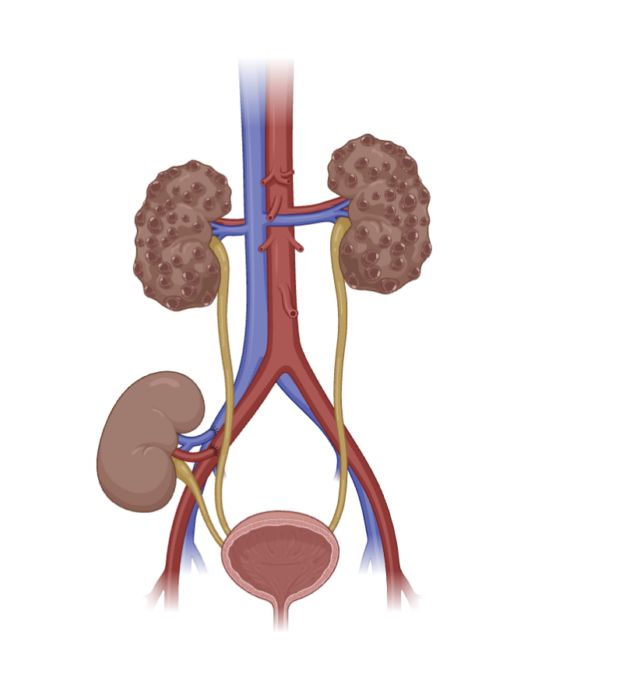
Transplant and paired donation
Living donor
Transplant-first
Paired exchange
Eligible patients should be referred before dialysis when possible. Preemptive transplant avoids many dialysis complications.
A living donor can shorten wait time and improve outcomes. Ask early and normalize the conversation.
An incompatible donor may still help through a swap or chain. Incompatibility is not the end of the story.
Nephrology for the Non-Nephrologist
Segev et al. JAMA 2005
25

Slide 33
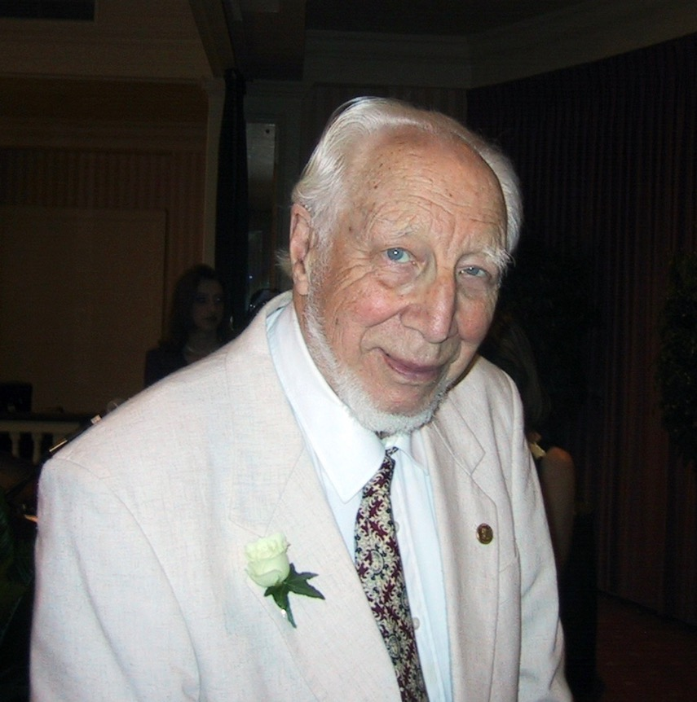
Timeline, 1966-2005: making kidney care better
1945 – First dialysis by Willem .J. (Pim) Kolff in the Netherlands
1954 – First kidney transplant – Joseph Murray at The Brigham
1960 – First chronic hemodialysis – William Schribner in Seattle
1966
1976
1994
2001
2002
2005
Brescia-Cimino fistula
CAPD concept
MDRD
RENAAL / IDNT
AASK / HEMO
Paired donation
26

Slide 34
Timeline, 2010-2024: changing kidney outcomes
2010
IDEAL
Do not start dialysis early by eGFR alone.
2015
SPRINT
BP intensity enters CKD cardiovascular discussion.
2019
CREDENCE
SGLT2 kidney outcome trial in diabetic CKD.
2020
DAPA-CKD
SGLT2 benefit with and without diabetes.
2020
FIDELIO
Finerenone kidney and CV benefit in diabetic CKD.
2023
EMPA-KIDNEY
SGLT2 evidence broadens further.
2024
FLOW / KDIGO
GLP-1 kidney outcomes and updated CKD framework.
Nephrology for the Non-Nephrologist
27

Slide 35
Take home message
CKD definition
Albuminuria
Kidney disease means an abnormal kidney test or kidney structure problem that persists and matters for health.
Protein in the urine is a glomerular stress signal
SGLT2 inhibitor
Dialysis timing
This lowers pressure inside the filters and protects the heart-kidney system.
We start when symptoms, safety, and readiness line up.
Transplant swap
Conservative care
An incompatible donor can still help through a swap or chain.
This is active kidney care focused on symptoms and goals without dialysis.
Nephrology for the Non-Nephrologist
31

Slide 36
Primary care checklist
Every CKD patient: eGFR trend, ACR, BP, diabetes status, medication safety, cardiovascular risk.
Every albuminuric CKD patient: RAS blockade if tolerated, SGLT2 inhibitor eligibility, BP, and sodium strategy.
Every Type 2 diabetic CKD patient: SGLT2 inhibitor, metformin appropriateness, GLP-1 RA discussion, finerenone eligibility if persistent albuminuria.
Every advanced CKD patient: anemia, acidosis, potassium, bone-mineral disease, nutrition, vaccines, symptoms, modality education.
Every kidney failure trajectory: transplant first if eligible, home options second, plan access, conservative care option.
Nephrology for the Non-Nephrologist
32

Slide 37
Selected landmark sources
1994 — Modification of Diet in Renal Disease Study (MDRD) — eGFR equation
2002 — African American Study of Kidney Disease and Hypertension (AASK)-ACEi slows progression
2002 — HEMO Study — Higher dialysis dose ineffective
2005 — Kidney Paired Donation Study — Expanded incompatible transplant opportunities
2010 — IDEAL Trial — Early dialysis showed no benefit
2019 — CREDENCE Trial — SGLT2 inhibitors protect kidneys
2020 — DAPA-CKD Trial — Dapagliflozin reduced CKD progression
2020 — FIDELIO-DKD Trial — Finerenone reduced renal outcomes
2022 — Kidney 2023 — EMPA-KIDNEY Trial — Empagliflozin broadly preserved kidney function
2024 — FLOW Trial — Semaglutide improved kidney outcomes
2024 — Kidney Disease: Improving Global Outcomes CKD Guideline (KDIGO
Nephrology for the Non-Nephrologist
33

Slide 38

Our mutual goals
  Identify risk early
  Protect the kidney-heart system
  Avoid preventable harm
  Early patient choice
  Avoid crashers
Refer wisely
Recognize
Protect
Plan
Nephrology for the Non-Nephrologist
34

